Slide 1
Team GroupBy Toyosi Bamidele , Uchenna Mgbaja

Slide 2
Outline
Problem
Solution
Data + Model
Feature Importance
MLE Stack
Future work

Slide 3
Problem
Understanding customer behavior in the e-commerce space, a business area altered during the pandemic due to increased demand for online purchases, improving the customer experience, to ensure customer retention and product monetization is critical. The main goal is optimizing the customer journey and shopping experience using a predictive model and recommendation system

Slide 4
Solution
1.Predictive Model:Uplift model(One and Two model approach)
What customers are likely to convert?
Who should we target primarily?
2.Recommendation System
What products should we recommend to our users based on their purchase history?
What products should we recommend to users based on items pairs from past basket purchases

Slide 5
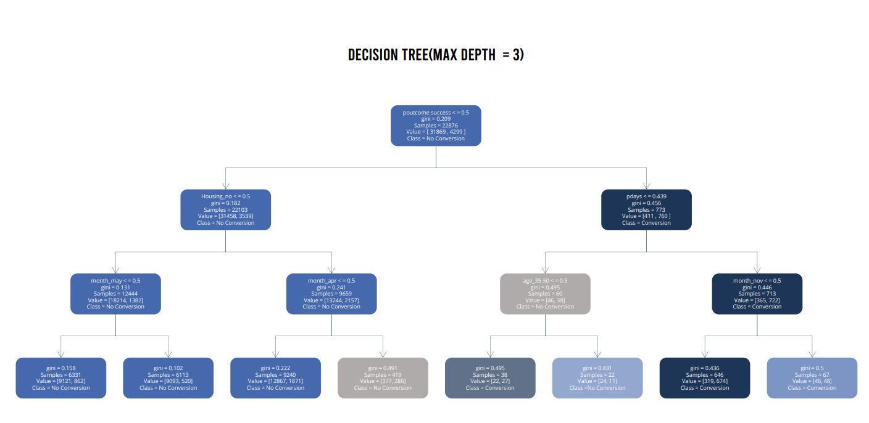
Feature Importance

Slide 6
Important Features from Decision Tree
outcome
p_days
Age
Month

Slide 7
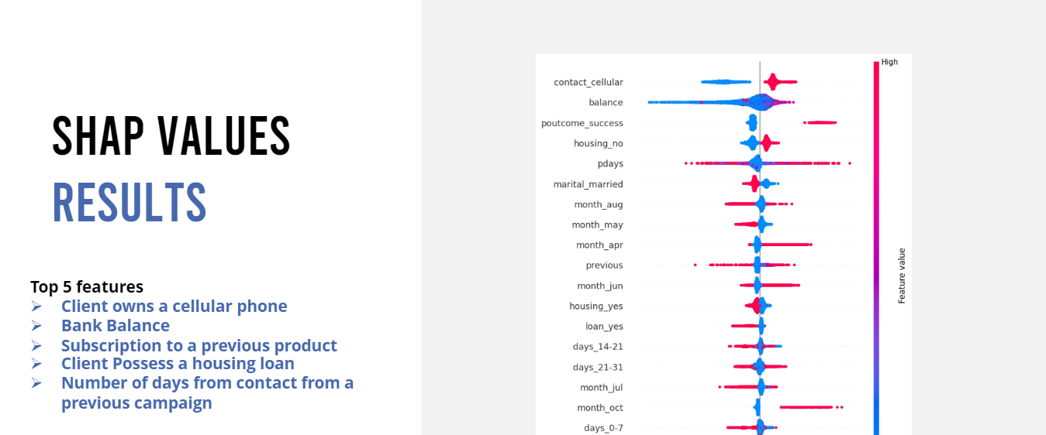
Feature Importance
Notes:
Any unique data wrangling/data-centric AI? If not, leave out. Lineage?
Pre-trained model? If not, why not? Fine-tuned? If not, why not?
Messy live data, modeling explainability aspects, ethical/responsible?
Choose wisely; time is of the essence; four bullets always better than five.
● Public dataset: Provided in Capstone
Kaggle E-Commerce events history in cosmetics shop data set
○ Online Retail Data set
Additional Datasets: Similar Datset that includes ‘boosted campaign’ feature
● https://www.kaggle.com/competitions/conversion-rate-prediction/data?select=train.csv

Slide 8
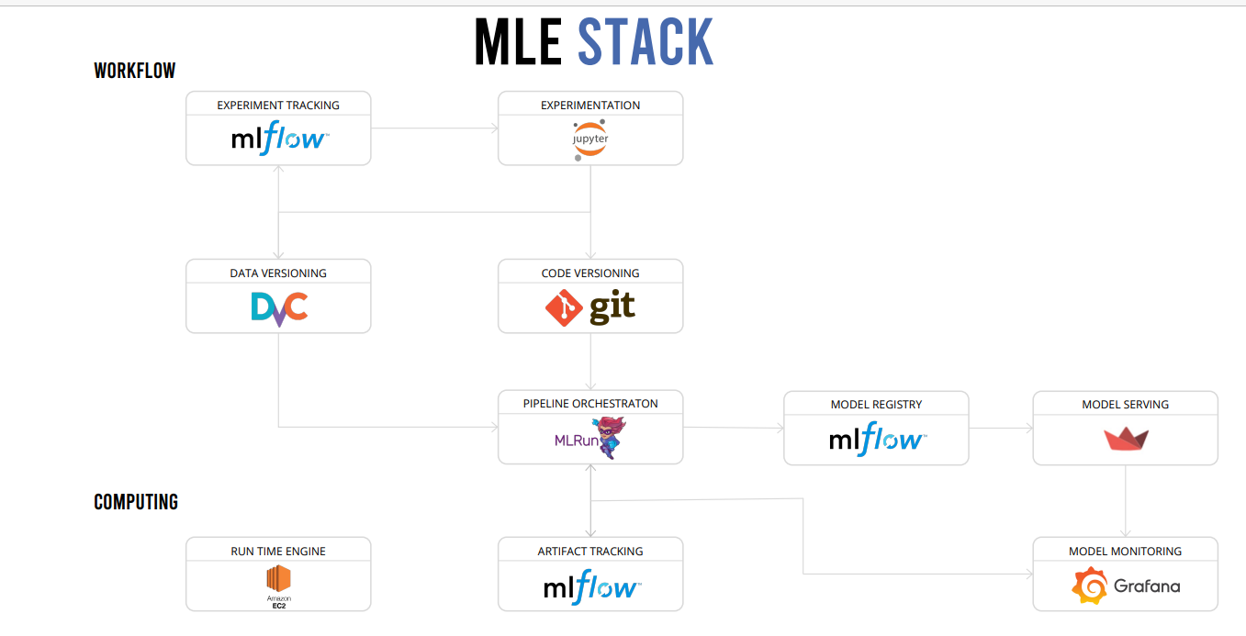
MLE Stack
Add your stack image here!

Slide 9
Conclusions & Future Work
Optimize Uplift Model App
Recommendation System
MLE Stack Optimization
Notes:
This is where you can tell funny stories about the stupid things you did!
This is also the slide where you might convey the difference between what you set out out to do, and what you actually did.

Slide 10
Thank You! Questions?

